Slide 1
Physical Layer & Data Link
Layer

Slide 2
PHYSICAL LAYER
Physical layer in the OSI model plays the role of interacting with actual hardware and signaling mechanism.
Physical layer is the only layer of OSI network model which actually deals with the physical connectivity of two different stations.
This layer defines the hardware equipment, cabling, wiring, frequencies, pulses used to represent binary signals etc.
Physical layer provides its services to Data-link layer. Data-link layer hands over frames to physical layer.
Physical layer converts them to electrical pulses, which represent binary data.
The binary data is then sent over the wired or wireless media.

Slide 3
GUIDED MEDIA
For any networking to be effective, raw stream of data is to be
transported from one device to other over some medium. Various transmission media can be used for transfer of data. These transmission media may be of two types −
Guided − In guided media, transmitted data travels through cabling system that has a fixed path. It is defined as the physical medium through which the signals are transmitted. It is also known as Bounded media. For example, copper wires, fibre optic wires,etc.
Unguided − In unguided media, transmitted data travels through free space in form of electromagnetic signal. For example, radio waves, lasers, etc.

Slide 4
TWISTED PAIR CABLES
Copper wires are the most common wires used for transmitting signals because
of good performance at low costs.
They are most commonly used in telephone lines.
However, if two or more wires are lying together, they can interfere with each other’s signals.
To reduce this electromagnetic interference, pair of copper wires are twisted together in helical shape like a DNA molecule.
Such twisted copper wires are called twisted pair.
To reduce interference between nearby twisted pairs, the twist rates are different for each pair.

Slide 5
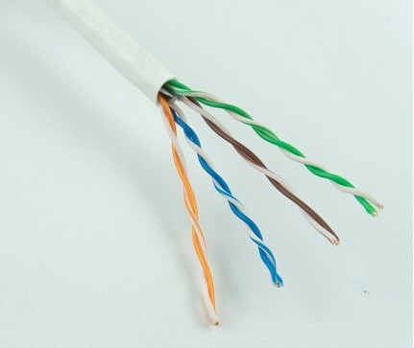
TWISTED PAIR CABLES

Slide 6
TWISTED PAIR CABLES
To counter the tendency of twisted pair cables to pick up noise signals, wires
are shielded in the following three ways −
Each twisted pair is shielded.
Set of multiple twisted pairs in the cable is shielded.
Each twisted pair and then all the pairs are shielded.
Such twisted pairs are called shielded twisted pair (STP) cables.
The wires that are not shielded but simply bundled together in a protective sheath are called unshielded twisted pair (UTP) cables. These cables can have maximum length of 100 metres.
Shielding makes the cable bulky, so UTP are more popular than STP. UTP cables are used as the last mile network connection in homes and offices.

Slide 7
COAXIAL CABLES
Coaxial cables are copper cables with better shielding than twisted pair cables, so that transmitted signals may travel longer distances at higher speeds. A coaxial cable consists of these layers, starting from the innermost −
Stiff copper wire as core
Insulating material surrounding the core
Closely woven braided mesh of conducting material surrounding the insulator
Protective plastic sheath encasing the wire
Coaxial cables are widely used for cable TV connections and LANs.

Slide 8
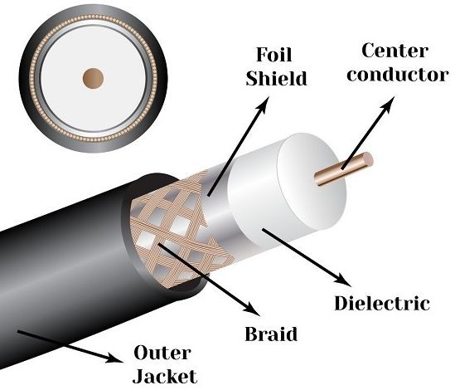
COAXIAL CABLES

Slide 9
COAXIAL CABLES
Advantages of Coaxial Cables
These are the advantages of coaxial cables −
Excellent noise immunity
Signals can travel longer distances at higher speeds, e.g. 1 to 2 Gbps for 1 Km cable
Can be used for both analog and digital signals
Inexpensive as compared to fibre optic cables
Easy to install and maintain
Disadvantages of Coaxial Cables
These are some of the disadvantages of coaxial cables −
Expensive as compared to twisted pair cables
Not compatible with twisted pair cables

Slide 10
FIBER OPTIC CABLE
Thin glass or plastic threads used to transmit data using light waves are called optical fibre. Light Emitting Diodes (LEDs) or Laser Diodes (LDs) emit light waves at the source, which is read by a detector at the other end.
Optical fibre cable has a bundle of such threads or fibres bundled together in a protective covering. Each fibre is made up of these three layers, starting with the innermost layer −
Core made of high quality silica glass or plastic
Cladding made of high quality silica glass or plastic, with a lower refractive index than the core
Protective outer covering called buffer
Note that both core and cladding are made of similar material. However, as refractive index of the cladding is lower, any stray light wave trying to escape the core is reflected back due to total internal reflection.

Slide 11
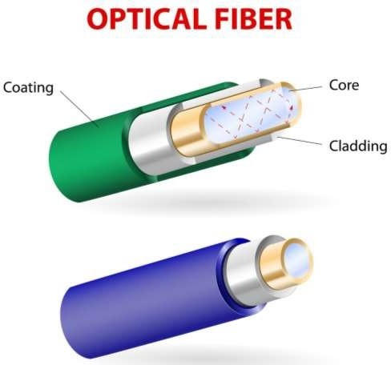

Slide 12
FIBER OPTIC CABLE
Advantages of Optical Fibre
Optical fibre is fast replacing copper wires because of these advantages that it offers −
High bandwidth
Immune to electromagnetic interference
Suitable for industrial and noisy areas
Signals carrying data can travel long distances without weakening
Disadvantages of Optical Fibre
Despite long segment lengths and high bandwidth, using optical fibre may not be a viable option for every one due to these disadvantages −
Optical fibre cables are expensive
Sophisticated technology required for manufacturing, installing and maintaining optical fibre cables
Light waves are unidirectional, so two frequencies are required for full duplex transmission

Slide 13
WIRELESS TRAMSIMISSION
The electromagnetic spectrum is the range of all possible frequencies of electromagnetic waves.
The spectrum is broken into regions/ranges and classified by frequency and/or wavelength.
The frequency (f ) of an electromagnetic wave is a measure of how rapidly it oscillates.
Frequency is measured in Hertz
The ES described as radio waves and micro waves are divided into eight ranges called as bands.

Slide 14
UNGUIDED MEDIA-RADIO WAVES
Transmission of data using radio frequencies is called radio-wave transmission.
We all are familiar with radio channels that broadcast entertainment programs.
Radio stations transmit radio waves using transmitters, which are received by the receiver installed in our devices.
Both transmitters and receivers use antennas to radiate or capture radio signals.
These radio frequencies can also be communication within the allocated range.
This range is usually 10 miles.
used for direct voice

Slide 15
UNGUIDED MEDIA-RADIO WAVES
Advantages of Radio Wave
These are some of the advantages of radio wave transmissions −
Inexpensive mode of information exchange
No land needs to be acquired for laying cables
Installation and maintenance of devices is cheap
Disadvantages of Radio Wave
These are some of the disadvantages of radio wave transmissions
Insecure communication medium
Prone to weather changes like rain, thunderstorms, etc.

Slide 16
UNGUIDED
MEDIA-MICROWAVES
It is a line of sight transmission i.e. the sending and receiving antennas need to be properly aligned with each other.
The distance covered by the signal is directly proportional to the height of the antenna.
Frequency Range:1GHz – 300GHz.
These are majorly used for mobile phone communication and television distribution.

Slide 17
UNGUIDED MEDIA-MICROWAVES
Advantages Of Microwave:
Microwave transmission is cheaper than using cables.
It is free from land acquisition as it does not require any land for the installation of cables.
Microwave transmission provides an easy communication in terrains as the installation of cable in terrain is quite a difficult task.
Communication over oceans can be achieved by using microwave transmission.

Slide 18
UNGUIDED MEDIA-MICROWAVES
Disadvantages of Microwave transmission:
Eavesdropping: An eavesdropping creates insecure communication. Any malicious user can catch the signal in the air by using its own antenna.
Out of phase signal: A signal can be moved out of phase by using microwave transmission.
Susceptible to weather condition: A microwave transmission is susceptible to weather condition. This means that any environmental change such as rain, wind can distort the signal.
Bandwidth limited: Allocation of bandwidth is limited in the case of microwave transmission.

Slide 19
UNGUIDED MEDIA-INFRARED WAVES
An infrared transmission is a wireless technology used for communication over short ranges.
The frequency of the infrared in the range from 300 GHz to 400 THz.
It is used for short-range communication such as data transfer between two cell phones, TV remote operation, data transfer between a computer and cell phone resides in the same closed area.
Characteristics Of Infrared:
It supports high bandwidth, and hence the data rate will be very high.
Infrared waves cannot penetrate the walls. Therefore, the infrared communication in one room cannot be interrupted by the nearby rooms.
An infrared communication provides better security with minimum interference.
Infrared communication is unreliable outside the building because the sun rays will interfere with the infrared waves.

Slide 20
SWITCHING
In large networks, there can be multiple paths from sender to receiver. The switching technique will decide the best route for data transmission.
Switching technique is used to connect the systems for making one-to-one communication.
There are two types of switching techniques:
Circuit Switching
Packet Switching

Slide 21
CIRCUIT SWITCHING
Circuit switching is a switching technique that establishes a dedicated path between sender and receiver.
In the Circuit Switching Technique, once the connection is established then the dedicated path will remain to exist until the connection is terminated.
Circuit switching in a network operates in a similar way as the telephone works. A complete end-to-end path must exist before the communication takes place.
In case of circuit switching technique, when any user wants to send the data, voice, video, a request signal is sent to the receiver then the receiver sends back the acknowledgment to ensure the availability of the dedicated path. After receiving the acknowledgment, dedicated path transfers the data.
Circuit switching is used in public telephone network. It is used for voice transmission. Fixed data can be transferred at a time in circuit switching technology.

Slide 22
CIRCUIT SWITCHING
Advantages Of Circuit Switching:
In the case of Circuit Switching technique, the communication channel is dedicated.
It has fixed bandwidth.
Disadvantages Of Circuit Switching:
Once the dedicated path is established, the only delay occurs in the speed of data transmission.
It takes a long time to establish a connection approx 10 seconds during which no data can be transmitted.
It is more expensive than other switching techniques as a dedicated path is required for each connection.
It is inefficient to use because once the path is established and no data is transferred, then the capacity of the path is wasted.
In this case, the connection is dedicated therefore no other data can be transferred even if the channel is free.

Slide 23
PACKET SWITCHING
The packet switching is a switching technique in which the message is sent in
one go, but it is divided into smaller pieces, and they are sent individually.
The message splits into smaller pieces known as packets and packets are given a unique number to identify their order at the receiving end.
Every packet contains some information in its headers such as source address, destination address and sequence number.
Packets will travel across the network, taking the shortest path as possible.
All the packets are reassembled at the receiving end in correct order.
If any packet is missing or corrupted, then the message will be sent to resend the message. If the correct order of the packets is reached, then the acknowledgment message will be sent.

Slide 24
PACKET SWITCHING
There are two approaches to Packet Switching:
Datagram Packet switching:
It is a packet switching technology in which packet is known as a datagram, is considered as an independent entity. Each packet contains the information about the destination and switch uses this information to forward the packet to the correct destination.
The packets are reassembled at the receiving end in correct order.
In Datagram Packet Switching technique, the path is not fixed.
Intermediate nodes take the routing decisions to forward the packets.
Datagram Packet Switching is also known as connectionless switching.

Slide 25
PACKET SWITCHING
Virtual Circuit Switching
Virtual Circuit Switching is also known as connection-oriented switching.
In the case of Virtual circuit switching, a preplanned route is established before the messages are sent.
Call request and call accept packets are used to establish the connection between sender and receiver.
In this case, the path is fixed for the duration of a logical connection.

Slide 26
DATA LINK LAYER
In the OSI model, the data link layer is a 4th layer from the top and
2nd layer from the bottom.
The communication channel that connects the adjacent nodes is known as links, and in order to move the datagram from source to the destination, the datagram must be moved across an individual link.
The main responsibility of the Data Link Layer is to transfer the datagram across an individual link.
The Data link layer protocol defines the format of the packet exchanged across the nodes as well as the actions such as Error detection, retransmission, flow control, and random access.

Slide 27
DATA LINK LAYER SERVICES-FRAMING
Framing is a point-to-point connection between two computers or devices consists of a wire in which data is transmitted as a stream of bits.
However, these bits must be framed into discernible blocks of information.
Framing is a function of the data link layer.
It provides a way for a sender to transmit a set of bits that are meaningful to the receiver.
A Frame consists of Header, Trailer and Payload.

Slide 28
TYPES OF FRAMING
1. Fixed size – The frame is of fixed size and there is no need to provide boundaries to the frame, length of the frame itself acts as delimiter.
Drawback: It suffers from internal fragmentation if data size is less than frame size
Solution: Padding

Slide 29
TYPES OF FRAMING
2. Variable size – In this there is need to define end of frame as well as beginning of next
frame to distinguish. This can be done in two ways:
Length field – We can introduce a length field in the frame to indicate the length of the frame. Used in Ethernet(802.3). The problem with this is that sometimes the length field might get corrupted.
End Delimeter (ED) – We can introduce an ED(pattern) to indicate the end of the frame. Used in Token Ring. The problem with this is that ED can occur in the data. This can be solved by:
Character/Byte Stuffing: Used when frames consist of character. If data contains ED then, byte is stuffed into data to diffentiate it from ED. Let ED = “$” –> if data contains ‘$’ anywhere, it can be escaped using ‘\O’ character.

Slide 30
TYPES OF FRAMING
2. Bit Stuffing: Let ED = 01111 and if data = 01111
–> Sender stuffs a bit to break the pattern i.e. here appends a 0 in data = 011101.
–> Receiver receives the frame.
–> If data contains 011101, receiver removes the 0 and reads the data.

Slide 31
ERROR CONTROL
Data Link Layer provides a reliable delivery service, i.e., transmits the network layer datagram without any error.
A reliable delivery service is accomplished with transmissions and acknowledgements.
A data link layer mainly provides the reliable delivery service over the links as they have higher error rates and they can be corrected locally, link at which an error occurs rather than forcing to retransmit the data.
Errors can be introduced by signal attenuation and noise.
Data Link Layer protocol provides a mechanism to detect one or more errors.
This is achieved by adding error detection bits in the frame and then receiving node can perform an error check.

Slide 32
FLOW CONTROL
Flow control is a technique that allows two stations working at different speeds to communicate with each other.
It is a set of measures taken to regulate the amount of data that a sender sends so that a fast sender does not overwhelm a slow receiver.
A receiving node can receive the frames at a faster rate than it can process the frame.
Without flow control, the receiver's buffer can overflow, and frames can get lost.
To overcome this problem, the data link layer uses the flow control to prevent the sending node on one side of the link from overwhelming the receiving node on another side of the link.

Slide 33
FLOW CONTROL
Flow control can be broadly classified into two categories:
Feedback based Flow Control In these protocols, the sender sends frames after it has received acknowledgments from the user. This is used in the data link layer.
Rate based Flow Control These protocols have built in mechanisms to restrict the rate of transmission of data without requiring acknowledgment from the receiver. This is used in the network layer and the transport layer.
Different mechanisms like Sliding Window, Stop and Wait etc are used for flow control.

Slide 34
DATA LINK LAYER PROTOCOLS
SIMPLE PROTOCOL:
The simple protocol has no flow control or error control.
It assumes that the receiver can handle any frame it receives.
STOP & WAIT PROTOCOL:Here stop and wait means, whatever the data that sender wants to send, he sends the data to the receiver.
After sending the data, he stops and waits until he receives the acknowledgment from the receiver.
The stop and wait protocol is a flow control protocol where flow control is one of the services of the data link layer.

Slide 35
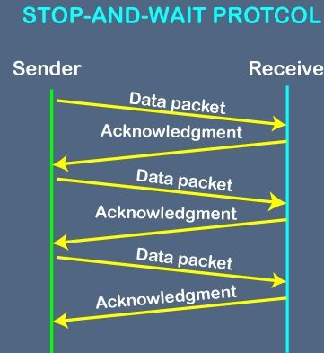
It is a layer protocol which is used for transmitting the data over the noiseless channels. It provides unidirectional data transmission which means that either sending or receiving of data will take place at a time. It provides flow-control mechanism but does not provide any error control mechanism.

Slide 36
SLIDING WINDOW-Go back-N ARQ
Go – Back – N ARQ provides for sending multiple frames before receiving the acknowledgment for the first frame. The frames are sequentially numbered and a finite number of frames. The maximum number of frames that can be sent depends upon the size of the sending window. If the acknowledgment of a frame is not received within an agreed upon time period, all frames starting from that frame are retransmitted.
The size of the sending window determines the sequence number of the outbound frames. If the sequence number of the frames is an n-bit field, then the range of sequence numbers that can be assigned is 0 to 2^{n}−1. Consequently, the size of the sending window is 2^{n}−1. Thus in order to accommodate a sending window size of 2^{n}−1, a n-bit sequence number is chosen.

Slide 37
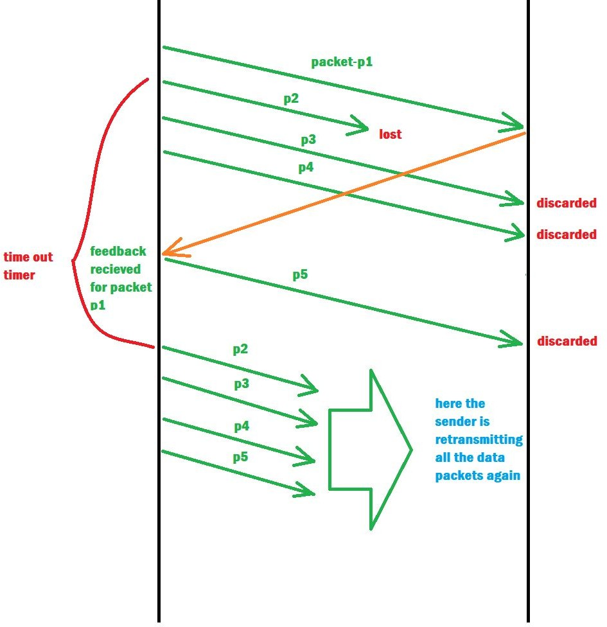

Slide 38
SELCETIVE REPEAT
The go-back-n protocol works well if errors are less, but if the line is poor it wastes a lot of bandwidth on retransmitted frames. An alternative strategy, the selective repeat protocol, is to allow the receiver to accept and buffer the frames following a damaged or lost one.
Selective Repeat protocol provides for sending multiple frames depending upon the availability of frames in the sending window, even if it does not receive acknowledgement for any frame in the interim. The maximum number of frames that can be sent depends upon the size of the sending window.
The receiver records the sequence number of the earliest incorrect or un-received frame. It then fills the receiving window with the subsequent frames that it has received. It sends the sequence number of the missing frame along with every acknowledgement frame.
The sender continues to send frames that are in its sending window. Once, it has sent all the frames in the window, it retransmits the frame whose sequence number is given by the acknowledgements. It then continues sending the other frames.

Slide 39
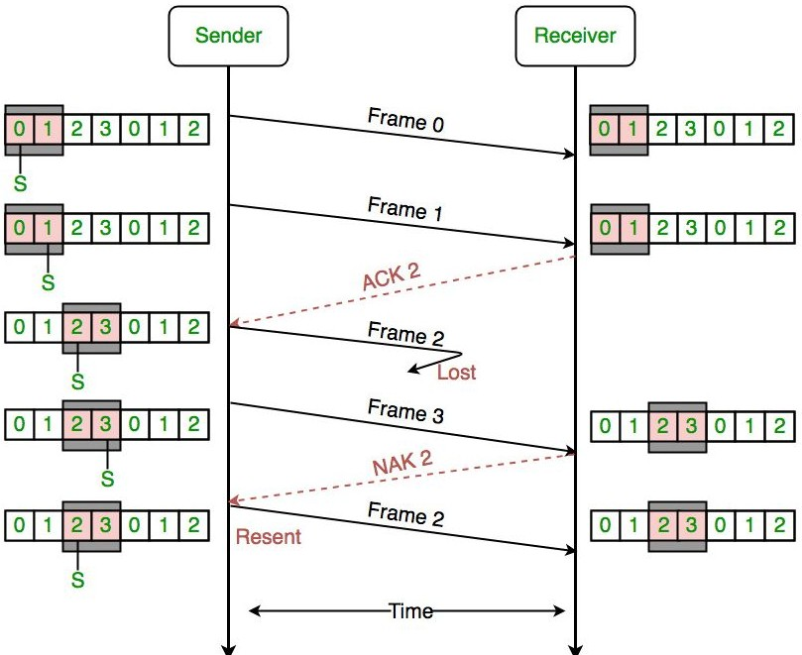

Slide 40
ERROR CORRECTION & DETECTION
There are many reasons such as noise, cross-talk etc., which may help data to get corrupted during transmission.
The upper layers work on some generalized view of network architecture and are not aware of actual hardware data processing.
Hence, the upper layers expect error-free transmission between the systems.
Most of the applications would not function expectedly if they receive erroneous data.
Applications such as voice and video may not be that affected and with some errors they may still function well.
Data-link layer uses some error control mechanism to ensure that frames (data bit streams) are transmitted with certain level of accuracy.
But to understand how errors is controlled, it is essential to know what types of errors may occur.

Slide 41
ERROR CORRECTION & DETECTION
A condition when the receiver’s information does not match with the sender’s information.
During transmission, digital signals suffer from noise that can introduce errors in the binary bits travelling from sender to receiver. That means a 0 bit may change to 1 or a 1 bit may change to 0.
Error control mechanism may involve two possible ways:
Error Detection- Errors in the received frames are detected by means of Parity Check and Cyclic Redundancy Check (CRC). In both cases, few extra bits are sent along with actual data to confirm that bits received at other end are same as they were sent. If the counter-check at receiver’ end fails, the bits are considered corrupted.
Error Correction

Slide 42
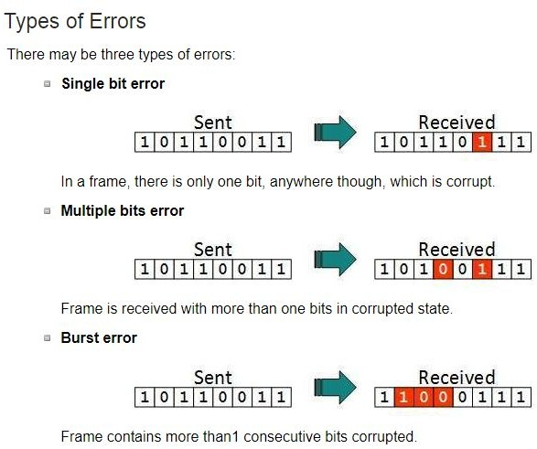

Slide 43
ERROR DETECTION
PARITY CHECKS
Blocks of data from the source are subjected to a check bit or parity bit generator form, where a parity of :
1 is added to the block if it contains odd number of 1’s, and
0 is added if it contains even number of 1’s
This scheme makes the total number of 1’s even, that is why it is called even parity checking.
You can also go for odd parity.

Slide 44
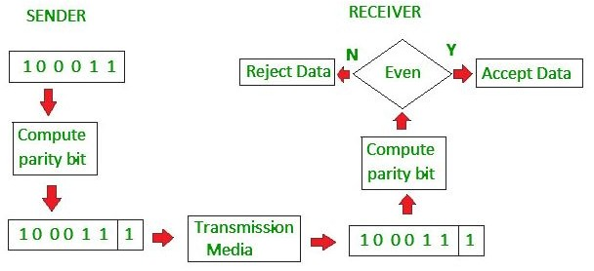

Slide 45
ERROR DETECTION
CHECKSUM
In checksum error detection scheme, the data is divided into k segments each of m bits.
In the sender’s end the segments are added using 1’s complement arithmetic to get the sum. The sum is complemented to get the checksum.
The checksum segment is sent along with the data segments.
At the receiver’s end, all received segments are added using 1’s complement arithmetic to get the sum. The sum is complemented.
If the result is zero, the received data is accepted; otherwise discarded.

Slide 46
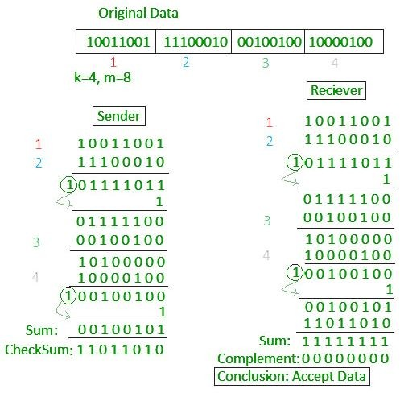

Slide 47
ERROR DETECTION
CYCLIC REDUNDANCY CHECK
Unlike checksum scheme, which is based on addition, CRC is based on binary division.
In CRC, a sequence of redundant bits, called cyclic redundancy check bits, are appended to the end of data unit so that the resulting data unit becomes exactly divisible by a second, predetermined binary number.
At the destination, the incoming data unit is divided by the same number. If at this step there is no remainder, the data unit is assumed to be correct and is therefore accepted.
A remainder indicates that the data unit has been damaged in transit and therefore must be rejected.

Slide 48
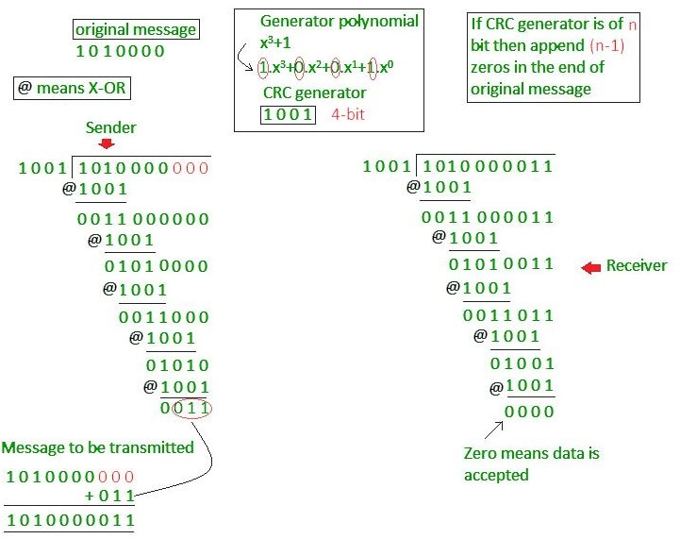

Slide 49
ERROR DETECTION
HAMMING CODE
Hamming code is a block code that is capable of detecting up to two simultaneous bit errors and correcting single-bit errors. It was developed by
R.W. Hamming for error correction.
In this coding method, the source encodes the message by inserting redundant bits within the message.
These redundant bits are extra bits that are generated and inserted at specific positions in the message itself to enable error detection and correction.
When the destination receives this message, it performs recalculations to detect errors and find the bit position that has error.

Slide 50
ERROR DETECTION-Hamming
Code
Encoding a message by Hamming Code
The procedure used by the sender to encode the message encompasses the following steps −
Step 1 − Calculation of the number of redundant bits.
Step 2 − Positioning the redundant bits.
Step 3 − Calculating the values of each redundant bit.
Once the redundant bits are embedded within the message, this is sent to the user.

Slide 51
ERROR DETECTION-Hamming
Code
Step 1 − Calculation of the number of redundant bits.
If the message contains m𝑚number of data bits, r𝑟number of redundant bits are added to it so that m𝑟 is able to indicate at least (m + r+ 1) different states.
Here, (m + r) indicates location of an error in each of (𝑚 +
𝑟) bit positions and one additional state indicates no error.
Since, r𝑟 bits can indicate 2^{r}𝑟 states, 2^{r}𝑟 must be at least equal to (m + r + 1). Thus the following equation should hold 2^{r} ≥ m+r+1

Slide 52
ERROR DETECTION-Hamming
Code
Step 2 − Positioning the redundant bits.
The r redundant bits placed at bit positions of powers of 2, i.e. 1, 2, 4, 8, 16 etc. They are referred in the rest of this text as r₁ (at position 1), r₂ (at position 2), r₃ (at position 4), r₄ (at position 8) and so on.
Step 3 − Calculating the values of each redundant bit.
The redundant bits are parity bits. A parity bit is an extra bit that makes the number of 1s either even or odd. The two types of parity are −Even Parity,Odd Parity.
Each redundant bit, r_{i}, is calculated as the parity, generally even parity, based upon its bit position. It covers all bit positions whose binary representation includes a 1 in the i^{th} position except the position of r_{i}

Slide 53
ERROR DETECTION-Hamming
Code
Decoding a message in Hamming Code
Once the receiver gets an incoming message, it performs recalculations to detect errors and correct them. The steps for recalculation are −
Step 1 − Calculation of the number of redundant bits.
Step 2 − Positioning the redundant bits.
Step 3 − Parity checking.
Step 4 − Error detection and correction

Slide 54
High-Level Data Link Control (HDLC)
High-Level Data Link Control (HDLC) basically provides reliable delivery of data frames over a network or communication link.
HDLC provides various operations such as framing, data transparency, error detection, and correction, and even flow control.
Primary stations simply transmit commands that contain address of secondary stations.
The secondary station then simply transmits responses that contain its own address.

Slide 55
High-Level Data Link Control (HDLC)
TRANSFER MODES
HDLC supports two types of transfer modes, normal response mode and asynchronous balanced mode.
Normal Response Mode (NRM) − Here, two types of stations are there, a primary station that send commands and secondary station that can respond to received commands. It is used for both point - to
- point and multipoint communications.
Asynchronous Balanced Mode (ABM) − Here, the configuration is balanced, i.e. each station can both send commands and respond to commands. It is used for only point - to - point communications.

Slide 56
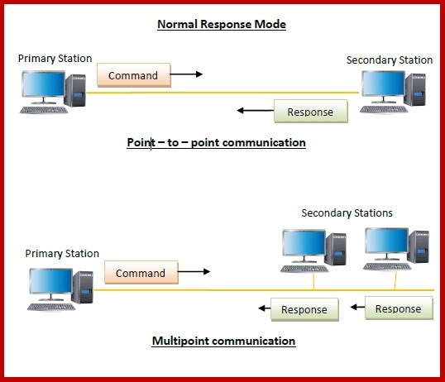
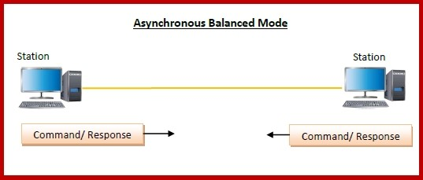

Slide 57
HDLC FRAME
HDLC Frame
HDLC is a bit - oriented protocol where each frame contains up to six fields. The structure varies according to the type of frame. The fields of a HDLC frame are −
Flag − It is an 8-bit sequence that marks the beginning and the end of the frame. The bit pattern of the flag is 01111110.
Address − It contains the address of the receiver. If the frame is sent by the primary station, it contains the address(es) of the secondary station(s). If it is sent by the secondary station, it contains the address of the primary station. The address field may be from 1 byte to several bytes.
Control − It is 1 or 2 bytes containing flow and error control information.
Payload − This carries the data from the network layer. Its length may vary from one network to another.
FCS − It is a 2 byte or 4 bytes frame check sequence for error detection. The standard code used is CRC (cyclic redundancy code)
⚫

Slide 58
HDLC FRAME
Types of HDLC Frames
There are three types of HDLC frames. The type of frame is determined by the control field of the frame −
I-frame − I-frames or Information frames carry user data from the network layer. They also include flow and error control information that is piggybacked on user data. The first bit of control field of I-frame is 0.
S-frame − S-frames or Supervisory frames do not contain information field. They are used for flow and error control when piggybacking is not required. The first two bits of control field of S-frame is 10.
U-frame − U-frames or Un-numbered frames are used for myriad miscellaneous functions, like link management. It may contain an information field, if required. The first two bits of control field of U-frame is 11.
⚫

Slide 59
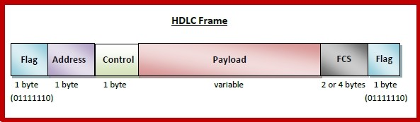
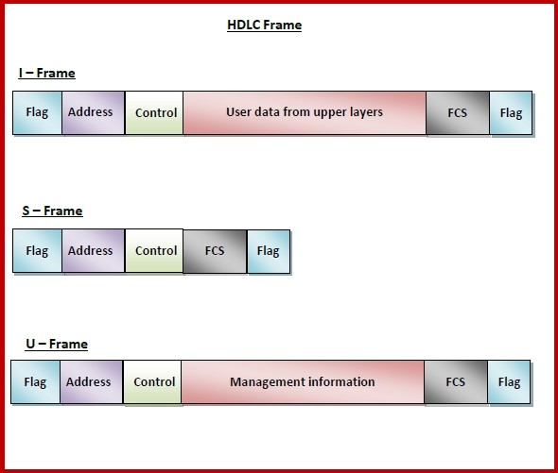

Slide 60
MEDIUM ACCESS CONTROL
Multiple Access Control – If there is a dedicated link between the sender and the receiver then data link control layer is sufficient, however if there is no dedicated link present then multiple stations can access the channel simultaneously.
Hence multiple access protocols are required to decrease collision and avoid crosstalk. For example, in a classroom full of students, when a teacher asks a question and all the students (or stations) start answering simultaneously (send data at same time) then a lot of chaos is created( data overlap or data lost) then it is the job of the teacher (multiple access protocols) to manage the students and make them answer one at a time.
Thus, protocols are required for sharing data on non dedicated channels. Multiple access protocols can be subdivided further as –
Random Access Protocols
Controlled Access Protocols
Channelization Access Protocols

Slide 61
MEDIUM ACCESS CONTROL
1. Random Access Protocol: In this, all stations have same superiority that is no station has more priority than another station. Any station can send data depending on medium’s state( idle or busy). It has two features:
There is no fixed time for sending data
There is no fixed sequence of stations sending data
The Random access protocols are further subdivided as:
(a) ALOHA – It was designed for wireless LAN but is also applicable for shared medium. In this, multiple stations can transmit data at the same time and can hence lead to collision and data being garbled.

Slide 62
ALOHA
Pure ALOHA and Slotted ALOHA both are the Random Access Protocols, that are implemented on the Medium Access Control (MAC) layer, a sublayer of Data Link Layer.
The purpose of the ALOHA protocol is to determine that which competing station must get the next chance of accessing the multi-access channel at MAC layer.

Slide 63
PURE ALOHA
It allows the stations to transmit data at any time whenever they want.
After transmitting the data packet, station waits for some time. then, following 2 cases are possible-
Case-01:
Transmitting station receives an acknowledgement from the receiving station.
In this case, transmitting station assumes that the transmission is successful.
Case-02:
Transmitting station does not receive any acknowledgement within specified time from the receiving station.
In this case, transmitting station assumes that the transmission is unsuccessful. Then,
Transmitting station uses a Back Off Strategy and waits for some random amount of time.
After back off time, it transmits the data packet again.
It keeps trying until the back off limit is reached after which it aborts the transmission.

Slide 64
PURE ALOHA
Efficiency of Pure Aloha (η) = G x e^{-2G}
where G = Number of stations willing to transmit data For maximum efficiency,
We put dη / dG = 0
Maximum value of η occurs at G = 1/2
Substituting G = 1/2 in the above expression, we get-
Maximum efficiency of Pure Aloha== 1/2 x e^{-2 x 1/2}
⚫ = 1 / 2e
⚫ = 0.184
⚫ = 18.4%

Slide 65
SLOTTED ALOHA
Slotted Aloha divides the time of shared channel into discrete intervals called as time slots.
Any station can transmit its data in any time slot.
The only condition is that station must start its transmission from the beginning of the time slot.
If the beginning of the slot is missed, then station has to wait until the beginning of the next time slot.
A collision may occur if two or more stations try to transmit data at the beginning of the same time slot.

Slide 66
SLOTTED ALOHA
Efficiency of Slotted Aloha (η) = G x e^{-G}
where G = Number of stations willing to transmit data at the beginning of the same time slot
Maximum Efficiency-
For maximum efficiency,
We put dη / dG = 0
Maximum value of η occurs at G = 1
Substituting G = 1 in the above expression, we get-
Maximum efficiency of Slotted Aloha
⚫ = 1 x e⁻¹
⚫ = 1 / e
⚫ = 0.368
⚫ = 36.8%

Slide 67
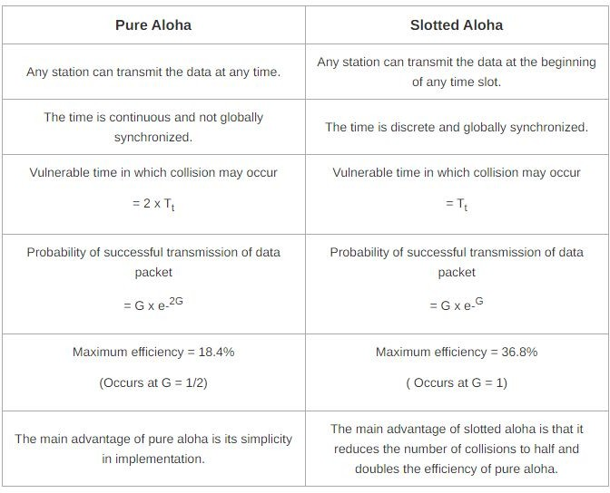

Slide 68
CSMA (Carrier Sense Multiple Access)
It is a carrier sense multiple access based on media access protocol to sense the traffic on a channel (idle or busy) before transmitting the data. It means that if the channel is idle, the station can send data to the channel. Otherwise, it must wait until the channel becomes idle. Hence, it reduces the chances of a collision on a transmission medium.
CSMA Access Modes
1-Persistent: In the 1-Persistent mode of CSMA that defines each node, first sense the shared channel and if the channel is idle, it immediately sends the data. Else it must wait and keep track of the status of the channel to be idle and broadcast the frame unconditionally as soon as the channel is idle.

Slide 69
CSMA (Carrier Sense Multiple Access)
Non-Persistent: It is the access mode of CSMA that defines before transmitting the data, each node must sense the channel, and if the channel is inactive, it immediately sends the data. Otherwise, the station must wait for a random time (not continuously), and when the channel is found to be idle, it transmits the frames.
P-Persistent: It is the combination of 1-Persistent and
Non-persistent modes. The P-Persistent mode defines that each node senses the channel, and if the channel is inactive, it sends a frame with a P probability. If the data is not transmitted, it waits for a (q = 1-p probability) random time and resumes the frame with the next time slot.

Slide 70
CSMA (Carrier Sense Multiple Access)
CSMA/ CD
It is a carrier sense multiple access/ collision detection network protocol to transmit data frames. The CSMA/CD protocol works with a medium access control layer. Therefore, it first senses the shared channel before broadcasting the frames, and if the channel is idle, it transmits a frame to check whether the transmission was successful. If the frame is successfully received, the station sends another frame. If any collision is detected in the CSMA/CD, the station sends a jam/ stop signal to the shared channel to terminate data transmission. After that, it waits for a random time before sending a frame to a channel.
CSMA/ CA
It is a carrier sense multiple access/collision avoidance network protocol for carrier transmission of data frames. It is a protocol that works with a medium access control layer. When a data frame is sent to a channel, it receives an acknowledgment to check whether the channel is clear. If the station receives only a single (own) acknowledgments, that means the data frame has been successfully transmitted to the receiver. But if it gets two signals (its own and one more in which the collision of frames), a collision of the frame occurs in the shared channel. Detects the collision of the frame when a sender receives an acknowledgment signal.

Slide 71
CONTROLLED ACCESS
Controlled Access Protocol
It is a method of reducing data frame collision on a shared channel. In the controlled access method, each station interacts and decides to send a data frame by a particular station approved by all other stations.
It means that a single station cannot send the data frames unless all other stations are not approved. It has three types of controlled access: Reservation, Polling, and Token Passing.

Slide 72
CHANNELIZATION PROTOCOLS
It is a channelization protocol that allows the total usable bandwidth in a shared channel to be shared across multiple stations based on their time, distance and codes. It can access all the stations at the same time to send the data frames to the channel.
Following are the various methods to access the channel based on their time, distance and codes:
FDMA (Frequency Division Multiple Access)
TDMA (Time Division Multiple Access)
CDMA (Code Division Multiple Access)

Slide 73
ETHERNET
Ethernet is primarily a standard communication protocol used to create local area networks.
It transmits and receives data through cables.
This facilitates network communication between two or more different types of network cables such as from copper to fiber optic and vice versa.
Ethernet network is used to create local area network and connect multiple computers or other devices such as printers, scanners, and so on.
In a wired network, this is done with the help of fiber optic cables, while in a wireless network, it is done through wireless network technology.
An Ethernet network uses various topologies such as star, bus, ring, and more.

Slide 74
ETHERNET
Ethernet may be either a wired or wireless network. In a wired network, various types of cables are used. Here are some widely used Ethernet cables:
10Base2: This is a thin twisted pair coaxial cable.
10Base5: This is thick twisted pair coaxial cables.
10Base T: This is a twisted pair cable which offers a speed of around 10 Mbps.
100BaseTX: This is a twisted pair cable and offer a speed of 100 Mbps.
100Base FX: Fiber optic protocol which offers a speed of 100 Mbps.
1000Base SX: Fiber optic protocol which utilizes a wavelength of 850nm for multimode networks.
1000Base LX: Fiber optic protocol which utilizes a wavelength of 1310 nm, for multimode networks and up to 1550nm for singlemode networks.

Slide 75
ETHERNET
Advantages- relatively low cost;
backward compatibility;
generally resistant to noise;
good data transfer quality;
reliability; and data security
Disadvantages
It is intended for smaller, shorter distance networks.
Mobility is limited.
Use of longer cables can create crosstalk.
It does not work well with real-time or interactive applications.
Increased traffic makes the Ethernet speed go down.
Receivers do not acknowledge the reception of data packets.
When troubleshooting, it is hard to trace which specific cable or node is causing the issue

Slide 76
TYPES OF ETHERNET
STANDARD ETHERENT: A standard Ethernet network can transmit data at a rate up to 10 Megabits per second (10 Mbps). Other LAN types include Token Ring, Fast Ethernet, Gigabit Ethernet, 10 Gigabit Ethernet, Fiber Distributed Data Interface (FDDI), Asynchronous Transfer Mode (ATM) and LocalTalk. A typical Ethernet Frame consist of:
PREAMBLE – Ethernet frame starts with 7-Bytes Preamble. This is a pattern of alternative 0’s and 1’s which indicates starting of the frame and allow sender and receiver to establish bit synchronization. Initially, PRE (Preamble) was introduced to allow for the loss of a few bits due to signal delays.
Start of frame delimiter (SFD) – This is a 1-Byte field which is always set to 10101011. SFD indicates that upcoming bits are starting of the frame, which is the destination address. Sometimes SFD is considered the part of PRE, this is the reason Preamble is described as 8 Bytes in many places. The SFD warns station or stations that this is the last chance for synchronization.
generated over the Destination Address, Source Address, Length, and Data field. If the checksum computed by destination is not the same as sent checksum value, data received is corrupted.

Slide 77
STANDARD ETHERNET
Destination Address – This is 6-Byte field which contains the MAC address of machine for which data is destined.
Source Address – This is a 6-Byte field which contains the MAC address of source machine. As Source Address is always an individual address (Unicast), the least significant bit of first byte is always 0.
Length – Length is a 2-Byte field, which indicates the length of entire Ethernet frame. This 16-bit field can hold the length value between 0 to 65534, but length cannot be larger than 1500 because of some own limitations of Ethernet.
Data – This is the place where actual data is inserted, also known as Payload. Both IP header and data will be inserted here if Internet Protocol is used over Ethernet. The maximum data present may be as long as 1500 Bytes. In case data length is less than minimum length i.e. 46 bytes, then padding 0’s is added to meet the minimum possible length.
Cyclic Redundancy Check (CRC) – CRC is 4 Byte field. This field contains a 32-bits hash code of data, which is

Slide 78
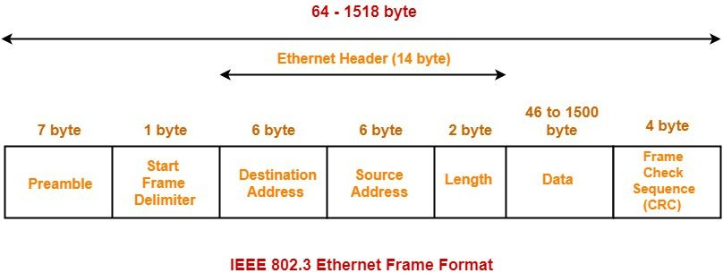

Slide 79
FAST ETHERNET
Fast Ethernet is a variation of Ethernet standards that carry data traffic at 100 Mbps (Mega bits per second) in local area networks (LAN). It was launched as the IEEE 802.3u standard in 1995, and stayed the fastest network till the introduction of Gigabit Ethernet.
Fast Ethernet is popularly named as 100-BASE-X. Here, 100 is the maximum throughput, i.e. 100 Mbps, BASE denoted use of baseband transmission, and X is the type of medium used, which is TX or FX.
The common varieties of fast Ethernet are 100-Base-TX, 100-BASE-FX and 100-Base-T4.

Slide 80
FAST ETHERNET
100-Base-T4
This has four pairs of UTP of Category 3, two of which are bi-directional and the other two are unidirectional.
In each direction, three pairs can be used simultaneously for data transmission.
Each twisted pair is capable of transmitting a maximum of 25Mbaud data. Thus the three pairs can handle a maximum of 75Mbaud data.
It uses the encoding scheme 8B/6T (eight binary/six ternary).
100-Base-TX
This has either two pairs of unshielded twisted pairs (UTP) category 5 wires or two shielded twisted pairs (STP) type 1 wires. One pair transmits frames from hub to the device and the other from device to hub.
Maximum distance between hub and station is 100m.
It has a data rate of 125 Mbps.
It uses MLT-3 encoding scheme along with 4B/5B block coding.

Slide 81
FAST ETHERNET
100-BASE-FX
This has two pairs of optical fibers. One pair transmits frames from hub to the device and the other from device to hub.
Maximum distance between hub and station is 2000m.
It has a data rate of 125 Mbps.
It uses NRZ-I encoding scheme along with 4B/5B block coding.

Slide 82
GIGABIT ETHERNET
Gigabit Ethernet (GbE) is the family of Ethernet technologies that achieve theoretical data rates of 1 gigabit per second (1 Gbps). It was introduced in 1999 and was defined by the IEEE 802.3ab standard.
The popular varieties of fast Ethernet are 1000Base-SX, 1000Base-LX, 1000BASE-T and 1000Base-CX.
1000BASE-CX
Defined by IEEE 802.3z standard
The initial standard for Gigabit Ethernet
Uses shielded twisted pair cables with DE-9 or 8P8C connector
Maximum segment length is 25 metres
Uses NRZ line encoding and 8B/6B block encoding

Slide 83
GIGABIT ETHERNET
1000BASE-SX
Defined by IEEE 802.3z standard
Uses a pair of fibre optic cables of a shorter wavelength having 770
860 nm diameter
The maximum segment length varies from 220 – 550 metres depending upon the fiber properties.
Uses NRZ line encoding and 8B/10B block encoding
1000BASE-LX
Defined by IEEE 802.3z standard
Uses a pair of fibre optic cables of a longer wavelength having 1270
1355 nm diameter
Maximum segment length is 500 metres
Can cover distances up to 5 km
Uses NRZ line encoding and 8B/10B block encoding

Slide 84
GIGABIT ETHERNET
1000BASE-T
Defined by IEEE 802.3ab standard
Uses a pair four lanes of twisted-pair cables (Cat-5, Cat-5e, Cat-6, Cat‑7)
Maximum segment length is 100 metres
Uses trellis code modulation technique

Slide 85
10 GIGABIT ETHERNET
In computer networks, 10-Gigabit Ethernet is the family of Ethernet technologies that achieve maximum rates up to 10 gigabits per second (10 Gbps). It is also known as 10GE, 10GbE or 10 GigE. It is defined by the IEEE 802.3ae-2002 standard.
10GE is a thousand times faster than standard Ethernet and supports only full-duplex communication. Multimode fiber having 0.85μ frequency is used for medium distances and single-mode fiber having 1.5μ frequency is used for long distances.
The popular varieties of fast Ethernet are:
10GBase-SR
Defined by IEEE 802.3ae standard
Uses fiber optic cables
Maximum segment length is 300 m
Deployed using multimode fibers having 0.85μ frequency

Slide 86
10 GIGABIT ETHERNET
10GBase-LR
Defined by IEEE 802.3ae standard
Uses fiber optic cables
Maximum segment length is 10 km
Deployed using single-mode fibers having 1.3μ frequency
10GBase-ER
Defined by IEEE 802.3ae standard
Uses fiber optic cables
Maximum segment length is 40 km
Deployed using single-mode fibers having 1.5μ frequency

Slide 87
10 GIGABIT ETHERNET
10GBase-CX4
Defined by IEEE 802.3ak standard
Uses 4 pairs of twin-axial cables
Maximum segment length is 15 m
Uses 8B/10B coding
10GBase-T
Defined by IEEE 802.3an standard
Uses 4 pairs of unshielded twisted pair cables
Maximum segment length is 100 m
Uses low-density parity-check code (LPDC code)

Slide 88
THANK YOU

